Slide 1
Pharma Value Chain
RKT

Slide 2
What is a Pharma value chain?
A pharma value chain is the step-by-step process that a company follows to create a drug or service, from the initial idea to the time it reaches the customer. At each stage, the company adds value to the drug, making it better, more efficient, or more useful
The value chain consists of:
Primary Activities – Directly involved in creating and delivering the product
Secondary Activities – Indirectly support and enhance primary activities

Slide 3
Primary Activities in Pharma Value Chain
These are the main steps to bring a new medicine from research to patients:
Drug Discovery & Development – Finding and creating new medicines.
Clinical Trials & Approval – Testing medicines for safety and getting government approval (like FDA).
Manufacturing & Production – Making medicines in large amounts.
Distribution & Logistics – Delivering medicines to hospitals, pharmacies, and stores.
Market Access & Sales – getting insurance coverage and making medicines available to patients.

Slide 4
Secondary Activities in Pharma Value Chain
Support Activities in Pharma Value Chain
Regulatory & Compliance – Following safety rules and government guidelines.
Technology & Innovation – Using AI and new tech to speed up drug discovery.
Human Resources – Hiring and training experts like scientists and pharmacists.

Slide 5









Key stakeholder in PVC
Patient
Physician
Hospital
Pharmacy
Insurance
Pharma Mfg.
Govt.
PBM

Slide 6
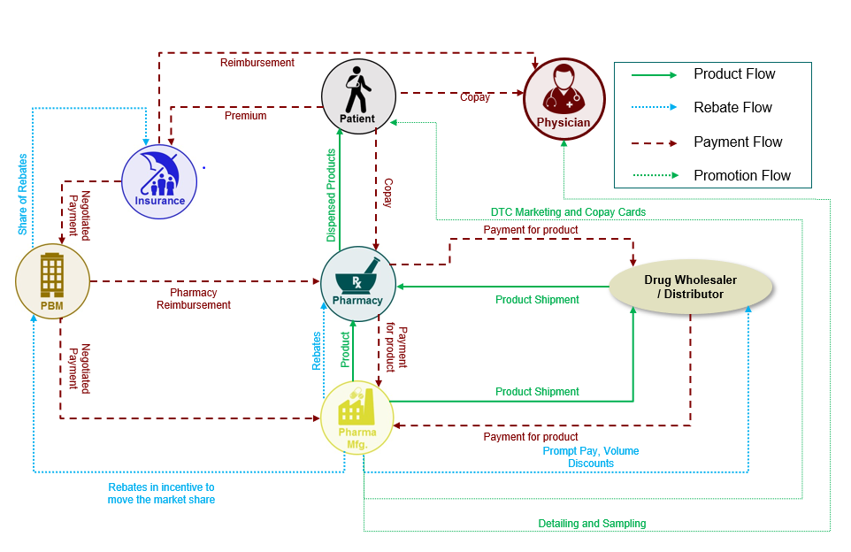

Slide 7
Wants to get well soon
Wants to avoid side effects due to medication
Doesn’t want to pay too much
Motivation
Patient
Provide the best possible healthcare to patients
Prevent adverse event
Cost cutting Treatments to Patients.
Motivation
Physician
Provide quality healthcare services to its patients
Increase its brand value and maximize patient intakes
Optimize Healthcare Cost
Hospital

Slide 8
Make margin / profit by selling medicines
Dispense medicines to patients without error
Solicit patients to repeat purchases
Motivation
Pharmacy
Maximize underwriting income (Premium collected – Insurance Claims)
Maximize investment income (by investing money not being used)
Motivation
Insurance
Motivation
Negotiate Prices – PBMs get discounts and rebates from drug makers for insurers.
Manage Formularies – They decide which drugs are covered and their costs.
Process Claims – They handle payments and ensure prescriptions follow insurance rules.
PBM

Slide 9
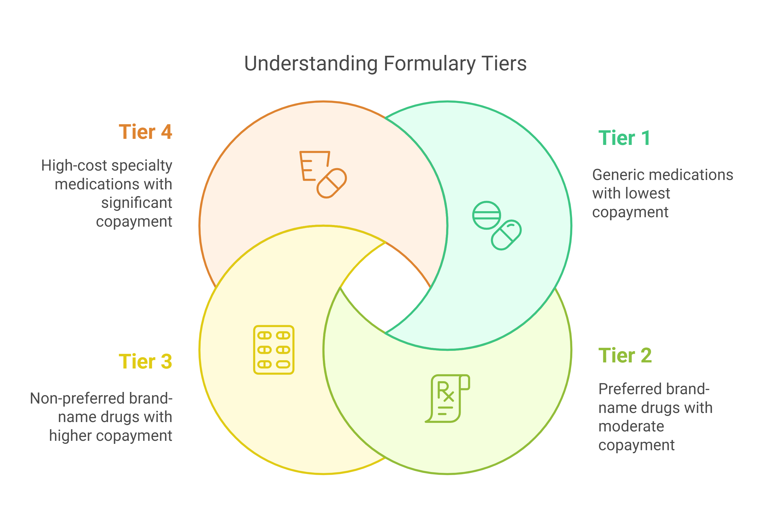
Formulary
A formulary is a list of prescription drugs covered by an insurance plan, categorized into different tiers based on cost and coverage.

Slide 10
Insurance
Public insurance
Medicare
Is a federal health plan
It was made available to elderly (65+)and included people with certain disabilities
It has 5 major parts
Part A - covers hospital care and services
Part B - covers medical care and services, including preventive care
Part C is also called Medicare Advantage. These plans combine Part A and B (and often Part D prescription drug coverage) into a single convenient plan
Part D - provides coverage for prescription drugs

Slide 11
Insurance
Medicaid
Medicaid is a public insurance program that provides health coverage to low-income families or individual
It is funded jointly by the federal government and the states
Varies with the state
Program Eligibility:
Low income pregnant women Low-income parents and other caretakers of children
Children in foster care
The Children's Health Insurance Program (CHIP) is a state and federally funded program designed to provide low-cost health coverage for children in families that don’t qualify for Medicaid but can’t afford private insurance

Slide 12
Insurance
Private Health Insurance - Private health insurance is typically offered through employers or purchased by individuals on their own
1. Health Maintenance Organization (HMO)
You must use doctors and hospitals in a specific network
You choose a primary doctor who helps manage your care and sends you to specialists if needed
Needs reference to use doctors inside the Network.

Slide 13
Insurance
2.Preferred Provider Organization (PPO)
You can see any doctor, even out of the network, but it costs more if you go outside
No need for a referral to see a specialist
More flexibility in choosing doctors
Higher premiums and out-of-pocket costs if you go out of network
3. Exclusive Provider Organization (EPO)
Like an HMO, but you don’t need a referral to see a specialist. However, you must stick to in-network doctors
No out-of-network coverage, except in emergencies
You can see specialists without a referral
You must stay in the network for care to be covered

Slide 14
Insurance
4.Point of Service (POS)
What it is: A mix of HMO and PPO. You need a referral from your primary doctor to see a specialist, but you can go out of network if needed
How it works: Like an HMO, but more flexible for out-of-network care
Pros: Some flexibility, but you still have a primary doctor guiding your care
Cons: Referrals required, and out-of-network care costs more

Slide 15
Insurance
Cost sharing in Health Insurance -
Deductible - The deductible is how much you pay before your health insurance starts to cover a larger portion of your bills.
Co-Insurance - Coinsurance is a percentage of a medical charge that you pay, with the rest paid by your health insurance plan, that typically applies after your deductible has been met.
Co-Pay - A predetermined rate you pay for health care services at the time of care.
Out-of-pocket maximum - The most you could have to pay in one year, out of pocket, for your health care before your insurance covers 100% of the bill

Slide 16
Govt Acts
HIPAA -
Keeps your health insurance even if you switch jobs.
Allows you to add family members (spouse, newborn, adopted child) without waiting for open enrollment.
Protects your medical records from being shared without permission.
Sunshine Act –
The Sunshine Act, officially known as the Physician Payments Sunshine Act, is a U.S. law that requires drug companies, medical device manufacturers, and other healthcare-related companies to report payments and other financial relationships they have with doctors, hospitals, and teaching institutions
The information is made publicly available on the Open Payments database
Affordable care Act–
Helps more people get insurance, especially those with low income.
Expands Medicaid to cover more low-income adults.
Stops insurance companies from denying coverage for pre-existing conditions.
Allows children to stay on their parents' insurance until age 26.

Slide 17
Terminologies
1. Clinical Trial
A research study where new treatments (like drugs or medical devices) are tested on people to see if they are safe and effective.
Example: Testing a new cancer drug to see if it works better than the current one.
2. Protocol
A detailed plan of how the clinical trial will be carried out. It includes information about:
Who can participate
What treatment will be given
What tests will be done
How long the study will last
Think of it like the “rulebook” for the trial.
3. Inclusion & Exclusion Criteria
These are the rules about who can or cannot take part in a trial.
Inclusion: Who is allowed (e.g., adults with Type 2 diabetes)
Exclusion: Who is not allowed (e.g., pregnant women)
Helps make sure results are safe and reliable.

Slide 18
4. Placebo
A “fake” treatment with no active ingredients. Used to compare against the real drug to see if the real one truly works.
Example: Sugar pills that look just like the real medicine.
5. Randomization
Participants are randomly assigned to different groups (e.g., treatment vs. placebo) to prevent bias.
It’s like drawing names from a hat – nobody gets to choose.
6. Blinding
A way to keep people in the trial unaware of which treatment they’re getting, so their expectations don’t affect the results.
Single-blind: Only the participant doesn’t know
Double-blind: Neither the participant nor the researchers know
7. Informed Consent
Before joining, participants are told all the risks, benefits, and details of the trial, and must sign a form agreeing to take part.
It ensures that participation is voluntary and well understood.

Slide 19
8. What Are Side Effects?
Side effects are unwanted but known effects of a drug or treatment. They are usually Expected, Often mild to moderate just inconvenience rather than a danger
Example:
Taking an antibiotic and getting an upset stomach
9. What Are Adverse Events?
Adverse events (AEs) are any negative or harmful effects that happen during a medical treatment or clinical trial, whether or not they are directly caused by the treatment. It can be mild, moderate, or severe
Might be unexpected
May require medical attention
Must be reported and monitored, especially in clinical trials
Example:
A person takes a new drug and suddenly experiences severe chest pain – even if it's not proven yet that the drug caused it, it’s still recorded as an adverse event.
An allergic reaction to a vaccine would be considered an adverse event, especially if it requires hospitalization.

Slide 20
10. Efficacy
How well the treatment works under ideal conditions (like a clinical trial).
If a new asthma inhaler improves breathing better than the old one, it has good efficacy.
11. Endpoint
The main outcome researchers are measuring in a trial.
Example: Tumor shrinkage, blood pressure drop, survival time.
12. Biomarker
A measurable sign in the body that can indicate disease or treatment response.
Example: High blood sugar is a biomarker for diabetes.
13. Cohort
A group of people in a study who share something in common — like age, disease type, or treatment.
14. Investigational New Drug (IND)
The new treatment being tested in the trial, before it’s officially approved.

Slide 21
15. Washout period:
Time during which a participant stops taking medication to clear it from their system.
16. Dropout:
A participant who leaves the study early.
17. Recruitment:
Finding and enrolling participants in a trial.
18. Data Monitoring Committee (DMC):
A group that checks data during the trial to ensure safety and ethics.
19. What is Morbidity?
Morbidity refers to having a disease or health condition. It doesn’t mean death — just that a person is unwell due to illness, injury, or other health issues.
It can be short-term (like the flu) or long-term (like diabetes or cancer).
A person can have more than one morbidity — this is called comorbidity.
Example: If someone has high blood pressure and diabetes, they have two morbidities.

Slide 22
20. What is Mortality?
Mortality refers to death — specifically, the number of deaths in a population during a certain time.
Often used in statistics and studies to show how deadly a disease is.
Expressed as a mortality rate (e.g., number of deaths per 1,000 people).
Example: If a disease causes 50 deaths in a population of 1,000, the mortality rate is 5%.
21. Mechanism of action
It refers to how a drug works inside the body to produce its effects. In simpler words, it explains What the drug does to the body — and how it does it
Common ways drugs act
1. Binding to Receptors : Painkillers like morphine bind to opioid receptors in the brain to reduce the feeling of pain.
2. Inhibiting Enzymes: Aspirin blocks an enzyme (COX) involved in inflammation, pain, and fever.
3. Killing or Stopping Growth of Cells: Antibiotics kill bacteria by disrupting their cell walls. Cancer drugs may block DNA replication to stop cancer cells from multiplying.
4. Replacing Substances: Insulin in diabetics replaces what the pancreas doesn’t produce.

Slide 23
Terminology | Definition
NCT-IDs | National Clinical Trial Numbers are identifications that clinicaltrails.gov assigns a study when it is assigned. NCT IDs are assigned by NCT followed by 8 digits.
Facility golden ID | It is the Unique ID provided by DQS for each site where the clinical trials are performed
NPI number | The National Provider Identifier (NPI) is a unique 10-digit identification number assigned to healthcare providers in the United States. The NPI is an intelligence-free numeric identifier, meaning that the numbers do not carry other information about healthcare providers, such as the state in which they live or their medical specialty
Study | Research study conducted on human volunteers to answer specific health questions

Slide 24
Terminology | Definition
Site | Location where the Clinical Trials are carried out
Therapeutic area | It is the disease area in which medical interventions are applied .
Indication | Indication in clinical trials is a disease that is expected to benefit from a treatment being tested
Sponsors | A person or an organization that manages and finances a clinical trial
Protocol | A protocol is a written statement to conduct the validation process along with the procedure, test method, equipment handling, specifications, acceptance criteria, report and approval
ABBV_INSTITUTION_ID | Unique site ID for AbbVie institution

Slide 25
Thank You!

